Slide 1


Nutan Maharashtra Vidya Prasarak Mandal’s NUTAN COLLEGE OF ENGINEERING AND RESEARCH Under Administrative Support of Pimpri Chinchwad Education Trust ISO 21001:2018 EOMS Certified
Seminar / Project Review - II / Project Presentation
Presentation on
“AI Health-Bot : Predictive Symptom Analysis and Voice-Based Treatment Recommendations”
By
Tanuj Choudhary[42]
Rohit Gaware [30]
Under Guidance Of
Prof. Priyanka Vyas
Department of Computer Science Engineering
(Artificial Intelligence)

Slide 2
Nutan Maharashtra Vidya Prasarak Mandal’s NUTAN COLLEGE OF ENGINEERING AND RESEARCH Under Administrative Support of Pimpri Chinchwad Education Trust ISO 21001:2018 EOMS Certified
Seminar / Project Review - II / Project Presentation
The AI Health-Bot project aims to revolutionize patient care and diagnosis by creating an innovative medical chatbot that offers predictive symptom analysis and voice-based treatment recommendations. Leveraging Natural Language Processing (NLP) for understanding user input and Deep Learning (DL) for disease prediction, the Health-Bot provides a comprehensive solution for immediate, accessible, and accurate health information.
Key features include the ability to analyze symptoms and predict potential diseases, recommend appropriate treatments and medications, and facilitate user interaction through voice commands, enhancing accessibility. Additionally, the system tracks user history, storing past interactions to ensure continuity of care and improve long-term health monitoring. The user-friendly graphical interface simplifies navigation, making advanced medical assistance accessible to users with varying levels of technological proficiency.
Introduction

Slide 3
Nutan Maharashtra Vidya Prasarak Mandal’s NUTAN COLLEGE OF ENGINEERING AND RESEARCH Under Administrative Support of Pimpri Chinchwad Education Trust ISO 21001:2018 EOMS Certified
Seminar / Project Review - II / Project Presentation
Designed with robustness and scalability in mind, the Health-Bot employs a flexible database for efficient data management, supporting current functionalities and future expansions.
Security and user privacy are prioritized through a secure login feature, ensuring that sensitive health information remains confidential.
By integrating advanced NLP and deep learning algorithms, voice-based input, a user-friendly GUI, and robust data management and security measures, the AI Health-Bot aims to enhance the accuracy, accessibility, and quality of medical consultations, empowering users with reliable health information and significantly improving overall patient care.

Slide 4
Nutan Maharashtra Vidya Prasarak Mandal’s NUTAN COLLEGE OF ENGINEERING AND RESEARCH Under Administrative Support of Pimpri Chinchwad Education Trust ISO 21001:2018 EOMS Certified
Seminar / Project Review - II / Project Presentation
Literature Survey
The literature review highlights research endeavors in AI Health-Bot development for predictive symptom analysis and voice-based treatment recommendations. Studies have employed advanced machine learning algorithms and NLP, aiming to enhance accuracy and user engagement.
However, challenges such as the need for large datasets, computational resources, and privacy concerns persist. Future efforts should focus on refining algorithms for stability, exploring deep learning techniques for improved accuracy, and integrating voice features for treatment recommendations.
For further details, please refer to the accompanying table. For detailed references and summaries of the reviewed literature, please refer to the following link :
https://drive.google.com/file/d/1_p00c4KxlgKUKb57ZxbU9g1enE3Hv16l/view?usp=sharing

Slide 5
Nutan Maharashtra Vidya Prasarak Mandal’s NUTAN COLLEGE OF ENGINEERING AND RESEARCH Under Administrative Support of Pimpri Chinchwad Education Trust ISO 21001:2018 EOMS Certified
Seminar / Project Review - II / Project Presentation
Objectives
The AI Enhanced Predictive Symptom Analysis : The primary goal of our project is to develop advanced Natural Language Processing (NLP) algorithms capable of accurately interpret user-reported symptoms. By leveraging deep learning algorithms, the system is designed to predict diseases and detect potential health issues at an early stage. Trained on a comprehensive dataset, these algorithms can understand and interpret a wide range of medical terminologies and symptoms.
Optimized Voice-Based Interaction System : Integrate Our project integrates state-of-the-art Automatic Speech Recognition (ASR) and NLP technologies to facilitate a seamless voice-based interaction system. This system accurately transcribes medical conversations, allowing users to describe their symptoms naturally and intuitively. The voice recognition component is finely tuned to understand various accents, dialects, and speech patterns, ensuring inclusivity and accessibility. This feature is particularly beneficial for users who may find typing challenging or inconvenient.

Slide 6
Nutan Maharashtra Vidya Prasarak Mandal’s NUTAN COLLEGE OF ENGINEERING AND RESEARCH Under Administrative Support of Pimpri Chinchwad Education Trust ISO 21001:2018 EOMS Certified
Seminar / Project Review - II / Project Presentation
3. Treatment Recommendations for user : Our chatbot is engineered to deliver tailored treatment suggestions based on the unique inputs provided by each user. The intelligent algorithms analyze the data collected during each session to offer guidance, ensuring that the advice given is relevant and specific to the individual's health condition. This customization extends to medication suggestions, lifestyle modifications, and follow-up care instructions.
4. Implement Privacy and Security Measures : To safeguard user information and ensure compliance with healthcare data regulations, our project implements robust privacy and security measures. These measures include secure data storage, ensuring that all user data remains confidential and protected from unauthorized access. We have developed a strong login and security feature that requires users to authenticate their identity before accessing the chatbot. This security measure is designed to prevent data breaches and ensure that user interactions with the chatbot are conducted in a secure environment

Slide 7
Nutan Maharashtra Vidya Prasarak Mandal’s NUTAN COLLEGE OF ENGINEERING AND RESEARCH Under Administrative Support of Pimpri Chinchwad Education Trust ISO 21001:2018 EOMS Certified
Seminar / Project Review - II / Project Presentation
Problem Statement
The current healthcare system faces significant challenges in providing timely and accurate diagnosis and treatment recommendations, particularly in remote or underserved areas. Traditional consultation methods often fail to effectively leverage advanced technologies like Natural Language Processing (NLP) and Deep Learning (DL), leading to inefficiencies and accessibility issues. Patients frequently encounter difficulties in accessing reliable medical advice promptly, exacerbating health conditions due to delayed interventions. Moreover, the lack of user-friendly interfaces, such as voice-based interactions, further limits the accessibility for individuals with disabilities or those less proficient with text-based inputs. There is a critical need for an AI-driven health application that integrates predictive symptom analysis and voice-based treatment recommendations to enhance diagnostic accuracy, streamline healthcare access, and provide personalized medical guidance.

Slide 8
Nutan Maharashtra Vidya Prasarak Mandal’s NUTAN COLLEGE OF ENGINEERING AND RESEARCH Under Administrative Support of Pimpri Chinchwad Education Trust ISO 21001:2018 EOMS Certified
Seminar / Project Review - II / Project Presentation
Methodology
Requirements gathering and Analysis
The initial phase of developing the AI Health-Bot involves comprehensive requirement gathering and analysis. This step is crucial for understanding the core functionalities and user expectations, which guide the entire project lifecycle. Key activities in this phase include identifying essential features such as symptom analysis, disease prediction, treatment recommendations, voice input integration, GUI development, and secure data management. Extensive research is conducted to grasp user needs and preferences in medical chatbot interactions, involving a thorough study of existing medical chatbots to identify successful features and shortcomings. Additionally, exploring relevant technologies such as Natural Language Processing (NLP), Deep Learning (DL), voice recognition systems, and web development frameworks provides insights into best practices and innovative approaches.

Slide 9
Nutan Maharashtra Vidya Prasarak Mandal’s NUTAN COLLEGE OF ENGINEERING AND RESEARCH Under Administrative Support of Pimpri Chinchwad Education Trust ISO 21001:2018 EOMS Certified
Seminar / Project Review - II / Project Presentation
2. System Design
The system design phase focuses on defining the architecture and interactions of the AI Health-Bot system components to ensure seamless integration and functionality. The architecture is designed to accommodate modules for NLP algorithms, DL models, voice input processing, GUI frontend, and database management. Each module's responsibilities and interactions are outlined to facilitate efficient data flow and processing. Clear definitions of functionalities for each component are established, detailing how NLP algorithms will analyze symptoms, extract pertinent information, and predict potential diseases. Similarly, the role of DL algorithms in processing complex medical data for disease prediction is meticulously defined.

Slide 11
Nutan Maharashtra Vidya Prasarak Mandal’s NUTAN COLLEGE OF ENGINEERING AND RESEARCH Under Administrative Support of Pimpri Chinchwad Education Trust ISO 21001:2018 EOMS Certified
Seminar / Project Review - II / Project Presentation
3. Development Environment Setup
Setting up the development environment is critical to support the effective implementation of various algorithms and system components. This involves selecting and configuring appropriate tools and frameworks for Python programming, NLP processing, DL model training, voice recognition, ensuring compatibility and optimal performance across different system functionalities. Additionally, necessary libraries and dependencies for text processing, neural networks, speech-to-text conversion, and frontend development frameworks are installed and configured to support the project requirements.

Slide 12
Nutan Maharashtra Vidya Prasarak Mandal’s NUTAN COLLEGE OF ENGINEERING AND RESEARCH Under Administrative Support of Pimpri Chinchwad Education Trust ISO 21001:2018 EOMS Certified
Seminar / Project Review - II / Project Presentation
4. Implementing NLP Algorithms
A significant task in the project is developing NLP algorithms to analyze user-input symptoms, extract relevant information, and predict potential diseases. Raw user inputs, typically in text format, undergo preprocessing to clean and normalize the text using techniques such as tokenization, stop word removal, and stemming or lemmatization. NLP models are trained to understand and interpret medical symptoms provided by users, employing techniques like named entity recognition (NER) to identify specific symptoms mentioned in the input text.

Slide 13
Nutan Maharashtra Vidya Prasarak Mandal’s NUTAN COLLEGE OF ENGINEERING AND RESEARCH Under Administrative Support of Pimpri Chinchwad Education Trust ISO 21001:2018 EOMS Certified
Seminar / Project Review - II / Project Presentation
5. Implementing Deep Learning Algorithms
The development of Deep Learning algorithms involves using neural networks to process data and predict potential diseases based on user symptoms. Relevant medical datasets containing symptom-disease relationships are collected and preprocessed, which may involve data cleaning, normalization, and feature extraction. Neural network architectures suitable for medical diagnosis, such as convolutional neural networks (CNNs) or recurrent neural networks (RNNs), are selected or designed and then trained to learn patterns and relationships between symptoms and diseases. These deep learning algorithms collaborate with NLP components to enhance disease prediction accuracy by receiving preprocessed symptom data from NLP modules and providing disease predictions back to the NLP system.

Slide 14
Nutan Maharashtra Vidya Prasarak Mandal’s NUTAN COLLEGE OF ENGINEERING AND RESEARCH Under Administrative Support of Pimpri Chinchwad Education Trust ISO 21001:2018 EOMS Certified
Seminar / Project Review - II / Project Presentation
RNN Training Algorithm
1. Initialize RNN model parameters.
2. Load dataset of symptom sequences and corresponding medical conditions.
3. While the model has not converged:
• Sample a batch of symptom sequences and their labels.
• Perform a forward pass through the RNN to compute predictions.
• Compute the loss using an appropriate loss function, such as crossentropy.
• Backpropagate gradients and update model parameters.

Slide 15
Nutan Maharashtra Vidya Prasarak Mandal’s NUTAN COLLEGE OF ENGINEERING AND RESEARCH Under Administrative Support of Pimpri Chinchwad Education Trust ISO 21001:2018 EOMS Certified
Seminar / Project Review - II / Project Presentation
6. Voice Input System Integration
The integration of a voice input system into the Health-Bot allows users to input symptoms and queries using voice commands, enhancing accessibility and user experience. Speech recognition libraries are utilized to convert spoken input from users into text format suitable for further processing by the NLP and DL algorithms. The converted text undergoes the same preprocessing steps as text inputs, ensuring consistency in handling both text and voice inputs within the Health-Bot system. Processed text from voice inputs is fed into the NLP algorithms for symptom analysis and disease prediction, ensuring that voice inputs are seamlessly processed and interpreted to provide accurate health-related information to users.

Slide 16
Nutan Maharashtra Vidya Prasarak Mandal’s NUTAN COLLEGE OF ENGINEERING AND RESEARCH Under Administrative Support of Pimpri Chinchwad Education Trust ISO 21001:2018 EOMS Certified
Seminar / Project Review - II / Project Presentation
Problem Identification and Solution
Limited Accuracy in Predictive Symptom Analysis:
Problem: The current predictive symptom analysis component of the AI Health-Bot may suffer from limited accuracy, leading to inaccuracies in predicting health conditions based on reported symptoms. This can result in misdiagnoses or delayed interventions, negatively impacting patient outcomes.
Solution:
Enhancing Predictive Symptom Analysis:
Solution: Implement advanced machine learning algorithms and techniques to enhance the accuracy and reliability of predictive symptom analysis. This could involve using more sophisticated models, such as deep learning algorithms, that can better capture complex patterns in symptom data. Additionally, incorporating a wider range of data sources, such as medical records or genetic information, can provide more comprehensive insights into a user's health status. Regular updates and refinements to the predictive models based on real-world feedback and performance monitoring can further improve accuracy over time.

Slide 17
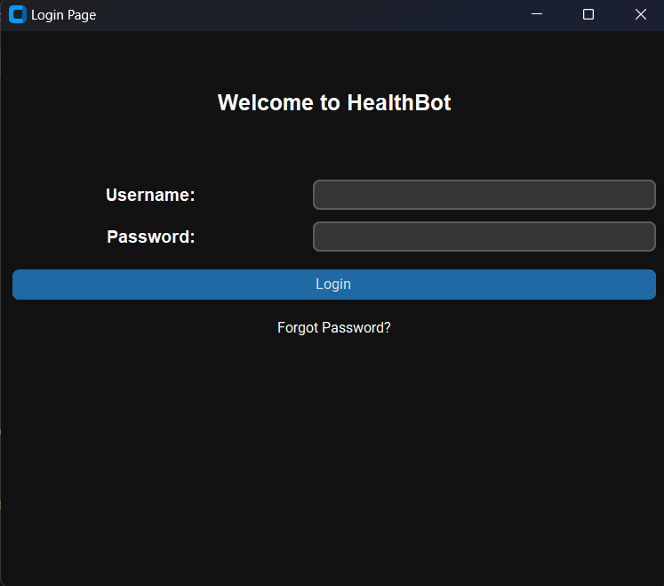
Nutan Maharashtra Vidya Prasarak Mandal’s NUTAN COLLEGE OF ENGINEERING AND RESEARCH Under Administrative Support of Pimpri Chinchwad Education Trust ISO 21001:2018 EOMS Certified
Seminar / Project Review - II / Project Presentation
Output
Login Page

Slide 18
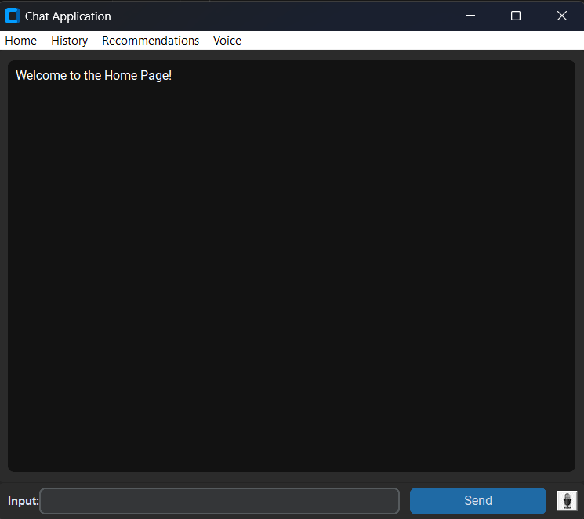
Nutan Maharashtra Vidya Prasarak Mandal’s NUTAN COLLEGE OF ENGINEERING AND RESEARCH Under Administrative Support of Pimpri Chinchwad Education Trust ISO 21001:2018 EOMS Certified
Seminar / Project Review - II / Project Presentation
Output
Chatbot Homepage

Slide 19
Nutan Maharashtra Vidya Prasarak Mandal’s NUTAN COLLEGE OF ENGINEERING AND RESEARCH Under Administrative Support of Pimpri Chinchwad Education Trust ISO 21001:2018 EOMS Certified
Seminar / Project Review - II / Project Presentation
Inefficient Voice-Based Interaction System:
Problem: The current voice-based interaction system may suffer from inefficiencies, leading to difficulties in accurately understanding user queries or commands. This can result in frustration and reduced user engagement, ultimately impacting the usability and effectiveness of the system.
Solution:
Optimizing Voice-Based Interaction System:
Solution: To address the inefficiencies in the voice-based interaction system, several approaches can be taken. Firstly, implementing state-of-the-art natural language processing (NLP) algorithms can improve the system's ability to accurately interpret and process user voice inputs. Additionally, conducting thorough testing and user feedback sessions can help identify and address any issues or challenges with the voice recognition system. Continuous improvements and refinements based on user feedback and performance monitoring can further optimize the voice-based interaction system over time. Finally, integrating error handling mechanisms and providing clear prompts and instructions to users can help mitigate misunderstandings and improve overall user experience.

Slide 20
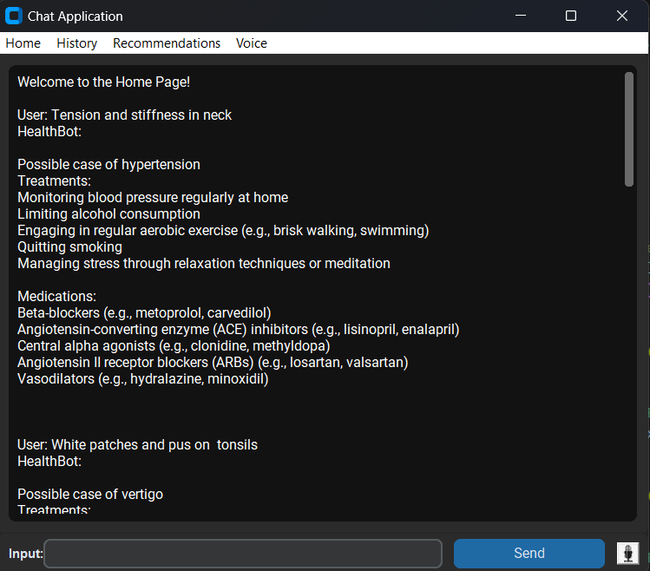
Nutan Maharashtra Vidya Prasarak Mandal’s NUTAN COLLEGE OF ENGINEERING AND RESEARCH Under Administrative Support of Pimpri Chinchwad Education Trust ISO 21001:2018 EOMS Certified
Seminar / Project Review - II / Project Presentation
Output
Disease Prediction and Treatment Recommendations

Slide 21
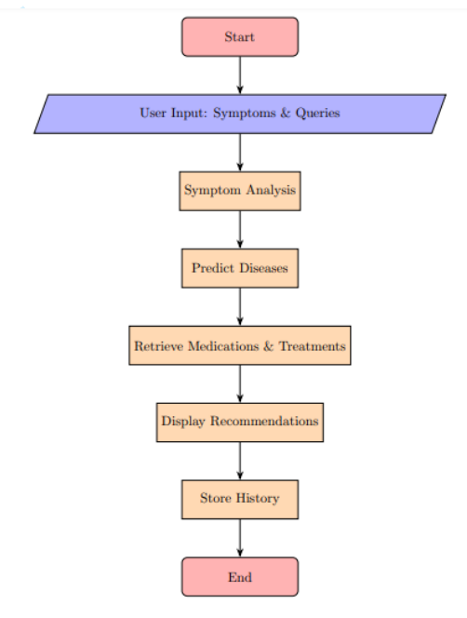
Nutan Maharashtra Vidya Prasarak Mandal’s NUTAN COLLEGE OF ENGINEERING AND RESEARCH Under Administrative Support of Pimpri Chinchwad Education Trust ISO 21001:2018 EOMS Certified
Seminar / Project Review – II / Project Presentation
System Architecture

Slide 22
Nutan Maharashtra Vidya Prasarak Mandal’s NUTAN COLLEGE OF ENGINEERING AND RESEARCH Under Administrative Support of Pimpri Chinchwad Education Trust ISO 21001:2018 EOMS Certified
Seminar / Project Review / Project Presentation
Advantages
By providing a user-friendly platform for users to input symptoms and receive personalized treatment recommendations, the AI Health-Bot enhances access to healthcare services, especially for individuals in remote or underserved areas.
The integration of a voice-based interaction system enhances accessibility for individuals with disabilities or those who may face challenges with traditional text-based interfaces, promoting inclusivity in healthcare access.
By facilitating early disease detection, personalized treatment recommendations, and preventive measures, the Health-Bot contributes to the reduction of healthcare costs associated with delayed diagnosis and unnecessary medical interventions.
Through the utilization of advanced NLP algorithms, the Health-Bot enables rapid and accurate analysis of user-reported symptoms, leading to timely disease identification and treatment initiation.

Slide 23
Nutan Maharashtra Vidya Prasarak Mandal’s NUTAN COLLEGE OF ENGINEERING AND RESEARCH Under Administrative Support of Pimpri Chinchwad Education Trust ISO 21001:2018 EOMS Certified
Seminar / Project Review - II / Project Presentation
Conclusion
In conclusion, the AI Health-Bot project demonstrates the potential of artificial intelligence and chatbot technology to revolutionize healthcare delivery. By providing timely, accurate, and personalized medical assistance, the Health-Bot aims to improve patient outcomes, enhance accessibility to healthcare services, and alleviate the burden on healthcare systems.
As technology continues to evolve, the AI Health-Bot will remain at the forefront of innovation, continuously adapting and improving to meet the evolving needs of users and healthcare professionals alike.

Slide 24
Nutan Maharashtra Vidya Prasarak Mandal’s NUTAN COLLEGE OF ENGINEERING AND RESEARCH Under Administrative Support of Pimpri Chinchwad Education Trust ISO 21001:2018 EOMS Certified
Seminar / Project Review - II / Project Presentation
Outcomes for society
Improved Healthcare Access : The AI Health-Bot enhances healthcare accessibility with its user-friendly GUI and voice-based interaction, particularly benefiting those in remote or underserved areas. By providing timely symptom analysis and treatment recommendations, it bridges gaps in healthcare access, ensuring life-saving interventions
Efficient Symptom Analysis : Utilizing advanced NLP algorithms, the Health-Bot conducts rapid and accurate symptom analysis. This ensures precise disease identification and appropriate treatment initiation. Continuous learning from vast datasets allows the Health-Bot to improve diagnostic accuracy by recognizing subtle symptom patterns.
Voice-Based Interaction Accessibility :The voice-based interaction system makes healthcare more accessible to individuals with disabilities or those who struggle with text-based interfaces. By enabling spoken commands and responses, the Health-Bot ensures inclusivity, promoting equal access to healthcare services for a broader demographic.

Slide 25
Nutan Maharashtra Vidya Prasarak Mandal’s NUTAN COLLEGE OF ENGINEERING AND RESEARCH Under Administrative Support of Pimpri Chinchwad Education Trust ISO 21001:2018 EOMS Certified
Seminar / Project Review - II / Project Presentation
4. Privacy and Security Assurance : Robust security measures, including encryption and secure authentication, safeguard sensitive health information. This prioritization of privacy cultivates user trust, encouraging accurate disclosure of medical histories and symptoms without concerns of data misuse.
5. Empowerment of Users : The intuitive GUI and voice interaction capabilities empower users to manage their healthcare actively. By providing access to medical information and treatment options, the Health-Bot fosters informed decision-making and proactive health behaviors, enhancing user control over their well-being.
6. Reduction of Healthcare Costs : The AI Health-Bot contributes to reducing healthcare costs through early disease detection, personalized treatments, and preventive measures. By promoting proactive health management, it minimizes complications and supports efficient resource allocation within healthcare systems.

Slide 26
Nutan Maharashtra Vidya Prasarak Mandal’s NUTAN COLLEGE OF ENGINEERING AND RESEARCH Under Administrative Support of Pimpri Chinchwad Education Trust ISO 21001:2018 EOMS Certified
Seminar / Project Review - II / Project Presentation
References
1) Char, D. S., Shah, N. H., Magnus, D., & Implementing Machine Learning in Health Care
Ethics, Governance, and Accountability Working Group. (2018). Implementing machine
learning in health care—addressing ethical challenges. New England Journal of Medicine,
378(11), 981-983. - This source discusses the ethical considerations involved in
implementing AI in healthcare, which is important for your project's privacy and security
aspects.
2) LeCun, Y., Bengio, Y., & Hinton, G. (2015). Deep learning. Nature, 521(7553), 436-444.
- A foundational paper on deep learning, which is a key technology for your AI HealthBot
project.
3) National Institute of Standards and Technology (NIST). (2020). NIST special publication
800-53: Security and privacy controls for information systems and organizations. - This
document provides guidelines on security and privacy controls, which are relevant to your
project's data privacy and security measures.

Slide 27
Nutan Maharashtra Vidya Prasarak Mandal’s NUTAN COLLEGE OF ENGINEERING AND RESEARCH Under Administrative Support of Pimpri Chinchwad Education Trust ISO 21001:2018 EOMS Certified
Seminar / Project Review - II / Project Presentation
References
4) World Health Organization (WHO). (2020). Telemedicine: Opportunities and
developments in Member States: Report on the second global survey on eHealth. - This
report from WHO discusses the growth and potential of telemedicine, which is a context
in which your AI HealthBot can operate.

Slide 28
Nutan Maharashtra Vidya Prasarak Mandal’s NUTAN COLLEGE OF ENGINEERING AND RESEARCH Under Administrative Support of Pimpri Chinchwad Education Trust ISO 21001:2018 EOMS Certified
Seminar / Project Review - II / Project Presentation
THANK YOU….!

